Slide 1
Immune system adaptation during gender-affirming testosterone treatment
Kaavya Akula, Joseph Soto, Marek Pinto, Julia Nowak

Slide 2
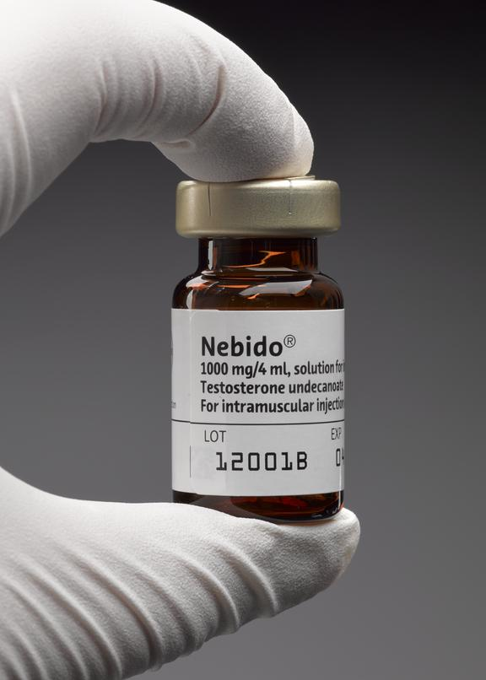
What is Gender Affirming Hormone Therapy (GAHT)?
Administration of estrogen or testosterone based medicine
Testosterone Therapy
Nebido
Administered once every 12 weeks
Patient doses = 1,000 mg or 750 mg based on body mass
Study Setup
23 adults assigned female at birth undergoing masculinizing gender-affirming treatment
Sweden
No previous testosterone treatment, abnormal sex hormone concentrations, or confounding immune diseases/deficiencies
https://coimages.sciencemuseumgroup.org.uk/70/162/medium_2014_0566__0005_.jpg
Notes:
https://coimages.sciencemuseumgroup.org.uk/70/162/medium_2014_0566__0005_.jpg

Slide 3

GAHT & Immune Response
What are the immunological impacts and risks of GAHT?
How do they manifest in individuals undergoing masculinizing testosterone treatment?
Changes in sex hormones
Active/inactive sex chromosomes
https://ghlf.org/wp-content/uploads/2024/06/1.png
Notes:
https://ghlf.org/wp-content/uploads/2024/06/1.png
Sex hormones are more dynamic and respond to needs of individual throughout lifetime - for example they affect women during menstrual cycle when of reproductive age
VS Sex chromosomes instead broadly modulate autosomal gene expression, and this is where gene mutations can cause further disease issues
In this paper
Find increased amounts of testosterone, lowered estrogen
Then designed experiments to decide “whether observed changes are associated directly with testosterone treatment or occur indirectly due to reduced oestradiol signals”

Slide 4


Systems Immunology Relevance
Sex related immunological impacts
Personalized medicine
Human immunology
Omics
Liquid chromatography
Mass spectrometry
Mass cytometry
RNA sequencing
Flow cytometry
Plasma protein profiling
https://media.istockphoto.com/id/1177896837/vector/restroom-gender-symbols.jpg?s=612x612&w=0&k=20&c=4vWuhz8yUfPQIqnHPbeS4UlTcti60cJKXZfBaNGTTCU=
https://biomedicalodyssey.blogs.hopkinsmedicine.org/files/2021/08/mrna-vaccine-development.jpg
Notes:
https://media.istockphoto.com/id/1177896837/vector/restroom-gender-symbols.jpg?s=612x612&w=0&k=20&c=4vWuhz8yUfPQIqnHPbeS4UlTcti60cJKXZfBaNGTTCU=
https://biomedicalodyssey.blogs.hopkinsmedicine.org/files/2021/08/mrna-vaccine-development.jpg

Slide 5
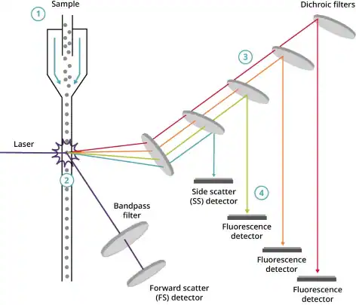
Flow Cytometry → What? Why? How?
Fluorescence detection of labelled antibodies or gene sequences
Events = cells
Forward vs side scatter
Laser excitations
https://a.static-abcam.com/CmsMedia/Media/multicolor-flow-cytometer-472-px.jpg
Notes:
https://a.static-abcam.com/CmsMedia/Media/multicolor-flow-cytometer-472-px.jpg
Flow cytometry
Method of detecting fluorescence of fluorescence labelled antibodies specific to cells or ligands on cells
How it works
Run cell suspension through flow cytometer, machine takes in cells one by one vie hydrodynamic focusing (controlled fluid flow)
Record each cell as an event
Each event has forward and side scatter recorded - helps differentiate types of cells
Forward = size of cell
Side = granularity of cell (complexity)
Also record fluorescent intensity of user chosen laser excitations
If cell is fluorescently labelled, laser excites fluorophore and records the excitation intensity
The laser detectors are photomultiplier tubes (PMTs), only detect at specific wavelength

Slide 6
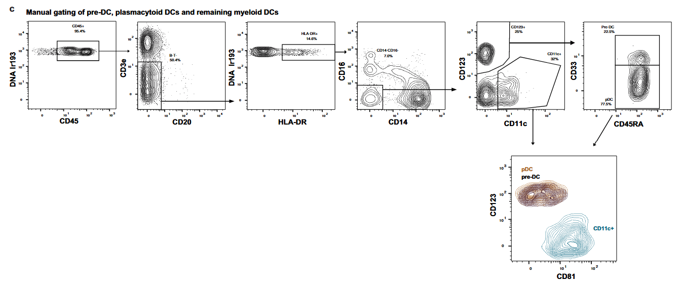
Flow Cytometry → What? Why? How?
Extended Data Fig 2c
Notes:
Paper specific gating strategy
Cd45 = marker for lymphocyte common antigen
Cd3e = gene on t cells
Cd20 = protein on b cells
Hla-dr = identifying effector T cells and monitoring immune response
Cd16 = on immune cells surface
Cd14 = mostly on macrophages
Cd123 = cell surface protein that helps transmit interleukin-3 (IL-3) signals
IL-3 is a cytokine that regulates the production and function of immune and hematopoietic cells
Found on plasmacytoid dendritic cells
Cd11c = common dendritic cell marker
Cd33 = also expressed on dendritic cells
Cd45 = protein that regulates function of dcs, affects how they mature
Cd81 = role in dc migration and function
Isolated down to Plasmacytoid dendritic cells, pre-dc cells, and cd11c pos dcs

Slide 7
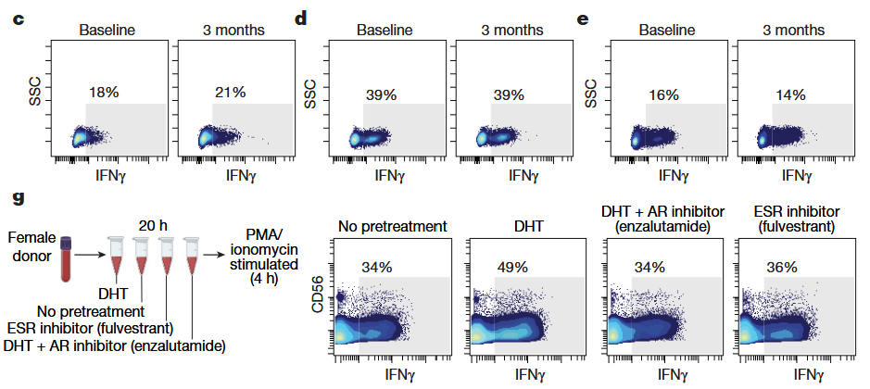
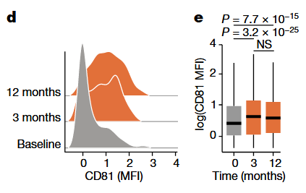
Flow Cytometry → What? Why? How?
Fig 2d, 2e & Fig 4c-e, 4g
Notes:
First flow example is following gating strategy from previous slide
Paper figure using flow cytometry
Surface expression of cd81 on pdcs increases from 3 months
This data comes from gating strategy explained
What do results mean?
Different from non positive pdcs
Attenuated type-I ifn responses, more potent regulatory t cell induction
Second flow cytometry example from paper
Pbmcs - peripheral blood mononuclear cells - taken from study cohort at baseline and 3 months
Cells stimulated with PMA/ionomycin (cell activator)
Using flow cytometry able to isolate out NK cells (natural killer), CD8+ t cells, and CD4+ t cells
Within isolated groups, looked at IFNy expression
Did same thing with female donor blood after different hormone treatments

Slide 8
What is mRNA sequencing?
Technique that uses next-generation sequencing to reveal the presence and quantity of RNA molecules in a biological sample, providing a snapshot of gene expression in the sample, also known as transcriptome
Facilitates the ability to look at changes in gene expression over time
Isolate RNA from samples
Fragment RNA into short segments & convert into cDNA
Ligate sequencing adapters & amplify
Perform NGS sequencing
Map sequencing reads to the transcriptome
(library prep)
Notes:
Complementary DNA (cDNA) is a synthetic DNA molecule that is a copy of messenger RNA (mRNA). It is created in a laboratory using reverse transcriptase, an enzyme that transcribes RNA into DNA

Slide 9
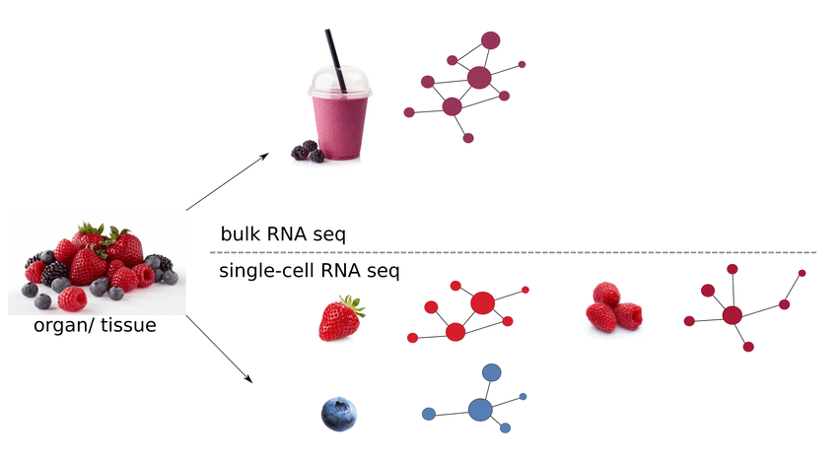
Bulk vs single-cell RNA sequencing
Bulk RNA seq:
Inferred networks would reflect an average of all the signals detected in the mixture of, potentially different, cells
Single-cell RNA seq:
Preserves information of different cell types and would allow for cell type specific gene correlation networks
https://www.researchgate.net/figure/Difference-in-resolution-from-bulk-and-single-cell-RNA-seq-data-on-the-level-of-gene_fig1_350593672
Notes:
input of sequencing experiments as various fruits (left) would result in a homogenized, mixed source material for bulk RNA-seq data, much like a fruit smoothie

Slide 10
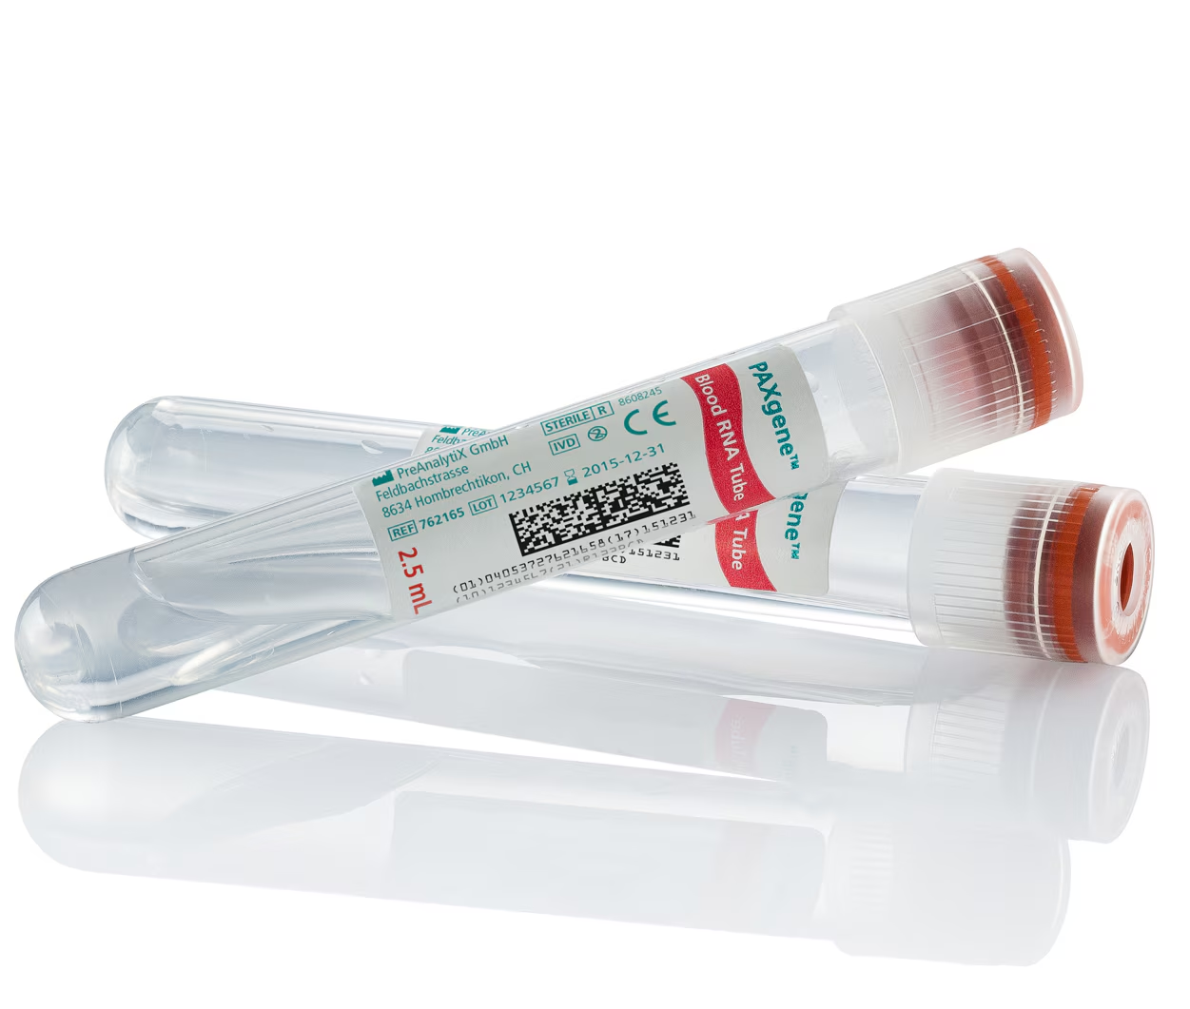
Bulk RNA seq
Sample preparation:
Using PAXgene blood RNA kit
Quality assessed before cDNA library prep
Measure RNA concentration
Determine RNA integrity number
Genes filtered out before assessing differential gene expression:
Genes with <100 reads across samples
Genes without a normalized count of 10 in at least ¼ samples
PAXgene blood collection tube
https://www.bdbiosciences.com/en-us/products/blood-collection/blood-collection-tubes/paxgene-blood-rna-tube.762165
Notes:
PAXgene blood RNA kit is intended for immediate stabilization of intracellular RNA. The kit integrates the key steps of whole blood collection, intracellular RNA stabilization, and RNA purification.
RNA integrity number shows you how degraded/ intact the RNA is
The results from the differential gene expression analysis were then used for gene set enrichment analysis of Hallmark pathways using clusterProfiler

Slide 11
Single-cell RNA seq
Uses cryopreserved Peripheral blood mononuclear cells (PBMCs)
Obtained at baseline and 3 months after treatment
Sample preparation:
Count cells
Plate cells
Incubate cells
Resuspend cells in PBS
Assess viability and cell counts
scRNA-seq using Genomics kit
Samples left untreated
Samples stimulated ex vivo with LPS
Samples stimulated ex vivo with R848
Notes:
Although it is not possible to obtain complete information on every RNA expressed by each cell, due to the small amount of material available, patterns of gene expression can be identified through gene clustering analyses.
LPS: Lipopolysaccharide. It can stimulate the release of interleukin 8 (IL-8, CXCL8, CXC ligand 8) and other inflammatory cytokines in various cell types, leading to an acute inflammatory response towards pathogens
R848: acts as an immune response modifier that activates immune cells through toll like receptors (TLRs). It mimics the pathogen-associated molecular patterns that activate immune cells through TLR7 and TLR8. Triggers the activation of human B cells

Slide 12
Hallmark Pathways
A collection of gene sets that summarize information about biological processes by highlighting genes that are expressed together
Uses:
Analyzing gene sets
Validating methods
Identifying key signaling pathways
Understanding disease
Notes:
This paper looks at hallmark inflammatory responses, interferon IFN⍺, and tumor necrosis factor (TNF) signalling
Hallmark generally means These proteins become non-functional or malfunctioning when the DNA sequence of their genes is damaged through acquired or somatic mutations. This happens in a series of steps called “hallmarks”

Slide 13
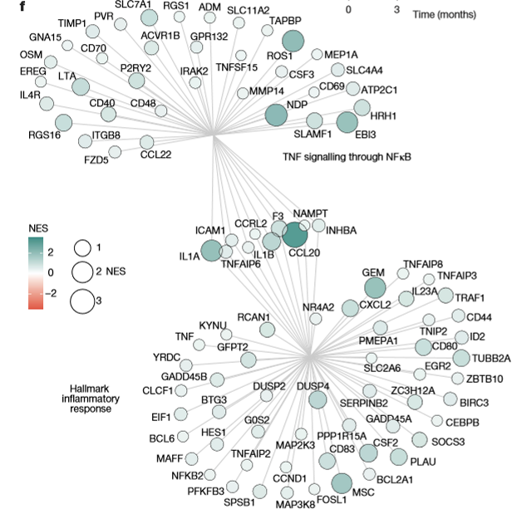
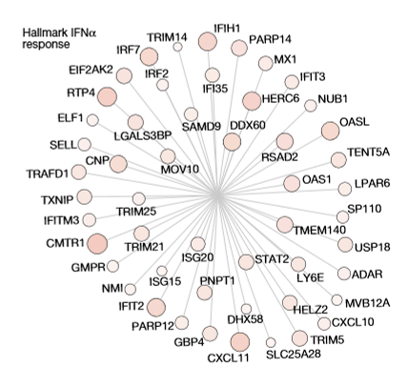
mRNA Trends
60 whole blood samples
Inflammation up
IFNα down

Slide 14
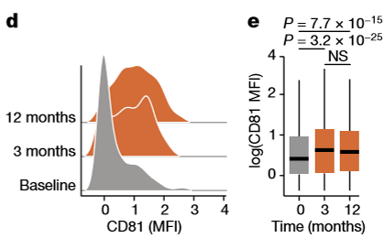
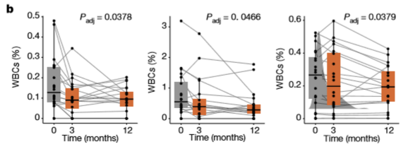
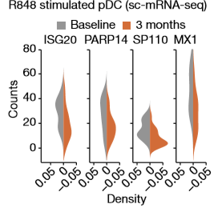
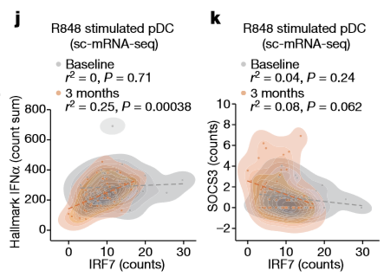
Explaining IFN attenuation
CD81 expression increased
Provoked pDCs induce IFN-associated genes less
IFNα response diminished in correlation with decrease in IRF7
CD8+ mucosa associated invariant T cells
CD24+ CD8+ T_{CM}
pDCs

Slide 15
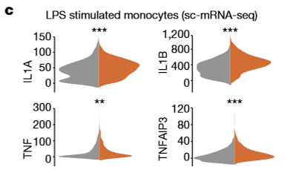
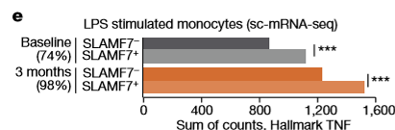
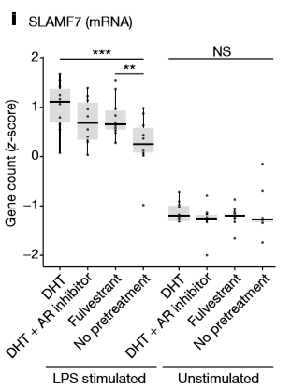
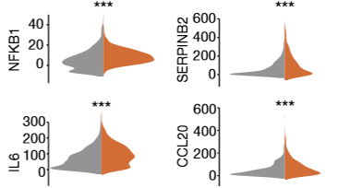
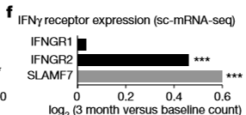

Explaining TNF stimulation
Provoked monocytes show upregulation of Hallmark TNF response
SLAMF7 and IFNγ related to TNF upregulation
Notes:
SLAMF7 known to potentiate TNF responses, and is itself induced by IFNgamma.

Slide 16
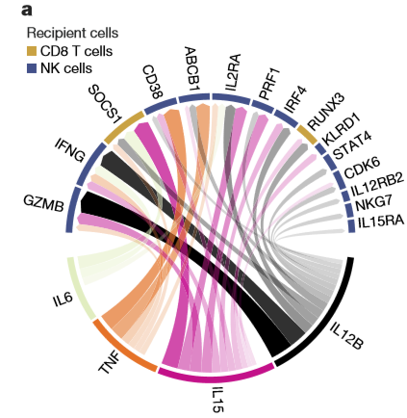
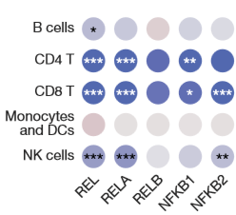

Considering downstream effects
NicheNet analysis infers downstream effects
sc-ATAC-seq reveals increased TF activity in NFκB binding sites
Notes:
NicheNet, as well as their existing analysis, reveals crossplay between TNF and IFN-I, so they select binding sites for JAK-STAT, AP-1, NF-kB, and MAPK TF binding sites. Only NF-kB sites (pictured) showed significant differences. Crossplay = IFN-I regulator SOCS1 and RUNX3 impacted by monocyte-derived IL-12B and IL-15.

Slide 17
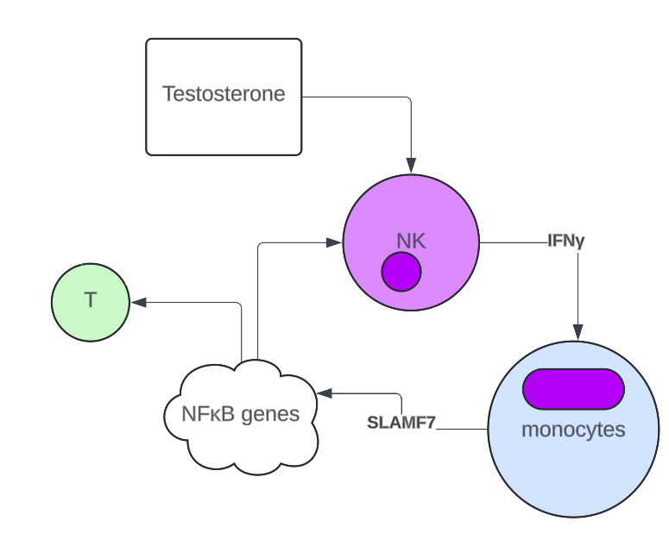
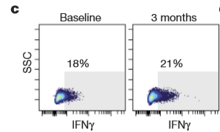
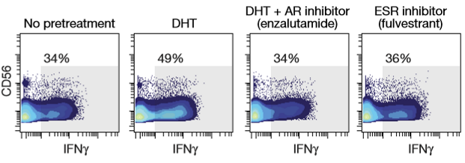
IFNγ Potentiation
Stronger IFNγ responses after testosterone treatment
Propose a loop of IFNγ production

Slide 18
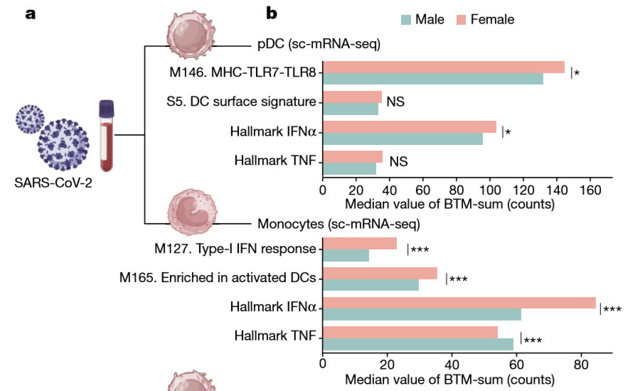
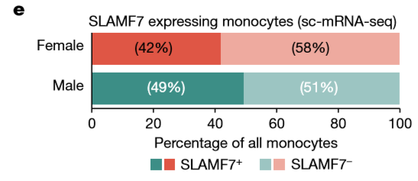
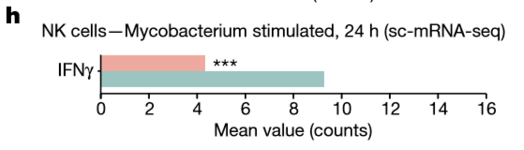
Database comparison during infection

Slide 19
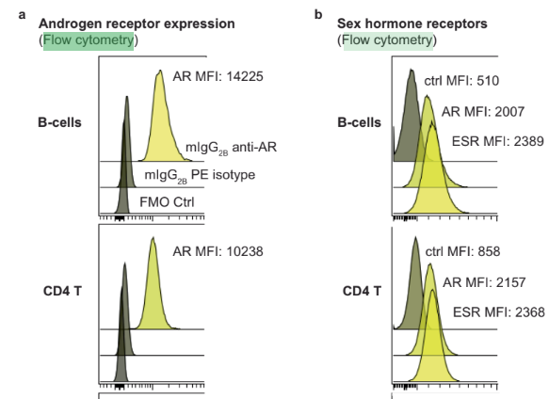
Advantages of Flow cytometry
High throughput
ESR Expression: One million live cells per test
Useful for identifying changes at scale in immune cells during testosterone therapy.
Provides quantitative data - can do statistical analysis on changes
Fig. 6a,b
Notes:
Flow cytometry is useful because it allows
Figure is comparing AR (androgen receptor) and ESR (estrogen receptor) expression across different types of immune cells - possible with quantitative nature of flow cytometry.

Slide 20
Limitations of Flow cytometry
Need to pre-select parameters to measure
Cannot measure many at once
Have to avoid overlaps in fluorescent labelling and/or compensate data
Many cells disappear during flow - can lose valuable data
Will lose all cells after a complete run
Can be complex and costly (time and money)
Notes:
Each fluorophore used in flow cytometry has specific excitation and emission spectra. When multiple fluorophores are used in an experiment, their emission spectra can overlap, leading to a phenomenon known as spectral spillover. This means that the light emitted by one fluorophore can be detected in the channel intended for another fluorophore, potentially causing inaccurate data interpretation.

Slide 21
Advantages of mRNA sequencing
Highly sensitive and accurate means of quantifying gene expression
Can identify both known and novel transcript isoforms, gene fusions, and other features as well as allele-specific expression
Delivers a complete view of the coding transcriptome
Can be applied across a wide range of species
Notes:
Novel transcript isoforms - can identify new transcripts
Gene fusions - two genes combined
can identify the genes that are expressed

Slide 22
Limitations of mRNA sequencing
Expensive
Time consuming
Often requires complex bioinformatics analysis
Lots of data generated
Additional steps to reduce background RNA and/or enrich for mRNAs can deplete the amount of original sample

Slide 23
Overall Strengths
Valuable for understanding the effects of testosterone on the immune response.
Provides insights on changes over time in response to hormone therapy.
Can generalize results to explain differences in immune cell phenotypes across gender.
Using human participants is important as model organisms have different sex hormone regulation systems.
Notes:
Lab mice do not menstruate and vary in their sex hormone regulation
In vitro could clarify mechanisms in humans but is disconnected from physiological regulation and endocrine pathways
increased investment into muscle growth could explain testosterone-mediated potentiation of TNF and suppression of IFN-1
Ensure wellbeing of trans men and avoid infection or inflammatory disorders.

Slide 24
Overall Limitations
Blood samples only collected at baseline, 3 months, and 12 months following testosterone injection.
Relatively small cohort (23 participants)
Difficult to isolate the effects of gonal steroids from secondary effects.
Different immune cell types have varying expression of AR and ESR proteins.
Notes:
Highest expression in pdCs and varied AR/ESR expression across cell types

Slide 25
Thank you!
Questions/ Comments?

